Slide 1

WELCOME COHORT ONE!
Deborah Simpson, PhD, Director – Education, Aurora Health Care
Carla DewBerry, Healthcare Attorney, DewBerry Legal
Lisa Howley, PhD, Senior Director, Transforming Medical Education, Association of American Medical Colleges
Virginia Mason Franciscan Health
UnityPoint Des Moines
OhioHealth (DUET)
Cleveland Clinic
Kaiser Permanente
Aurora Health Care (Professionalism)
RWJBH Monmouth Medical Center
NI X Meeting Three Storyboard Presentations

Slide 2

11:35 – 1:45 pm: Storyboard Presentations
Welcome & Introductions
  Facilitator: Deborah Simpson, PhD, Director – Education, Aurora Health Care
  National Advisory Council: Carla DewBerry, Healthcare Attorney, DewBerry Legal and Lisa Howley, PhD, Senior Director, Transforming Medical Education, Association of American Medical Colleges
Assign a Timekeeper
8-10 Minute Storyboard Presentations
Purpose: Share & Learn = Please provide feedback & join in discussion after each presentation
1:35 – 1:45: Overall Reflections from Facilitator & National Advisory Council
1:00 – 1:10 pm: Suggested Break time
(Facilitators and team to determine when/if a short break is needed)
Notes:
Read the slide which describes today’s objectives Be sure to note there are two options for time keeping:
If you take the 10-minute break:
7 projects @120 minutes = 12-minute presentations & 5 minutes for group feedback
If you do not take the 10-minute break:
7 projects @ 130 minutes = 13-minute presentations & 5 minutes for group feedback

Slide 3
Virginia Mason Franciscan Health

Slide 4



From Tools to Implementation & Mentorship: Sustaining a GME Well-Being & Burnout Prevention Curriculum
Kate Lukshin, MD; Kasey Jackson, MD; Keri Rowley, MD; Wright Clarkson, MD;
Joseph Strunk, MD; Claudia Serrano; Heather Seabott; Gillian Abshire, RN | Virginia Mason Franciscan Health GME
Introduction: Background & Context
Interventions/Changes
Results: Preliminary
Across VMFH’s 15 GME programs, well-being education and access to resources were are inconsistently applied and utilized. Program leaders/faculty reported uncertainty about how to guide trainees to resources, while residents/fellows report difficulty knowing where to find help.
The first phase standardized and centralized practical tools. The next phase focuses on reliable implementation and mentorship by program leaders.
RPIW/VMPS improvement work created and deployed:
• Centralized GME well-being webpage and site-specific links
• Badge buddy with quick-access resources
• Program Leader Roadmap / minimum expectations
• Well-being & burnout presentation materials
• Well-being Milestone rating guidance and CCC prompts
• Standard work for website maintenance and recurring program review
Next-phase change: Provide processes and development opportunities supporting program leaders ( PDs/PCs) to consistently promote and nurture lifelong “wellbeing” practices.
90-day progress
• Resident/fellow knowledge defect: 68% → 58.33% (Target = 0)
• Program leader resource-access defect: 65% → 16.67% (Target = 0)
• 5S resource organization: Level 1 → 4.6 (Target = 4)
• Resource-location test: 50% unable → 11% unable; mean successful time 3:23 → 0:36 (Target = 0)
• Well-being milestone: 13% → 21% (regressed; interpretation under review) (Target = 0)
Measures
Discussion
Aim/Objectives/Alignment
• Resident/fellow knowledge & resource-access defect rate
• Program leader access-to-tools defect rate
• ACGME “Self-Awareness and Help-Seeking” scores
• 5S resource-organization score
• Ability/time to locate key resources
• Baseline, 30-, 60-, and 90-day remeasures
Critical next steps
• Develop a directed implementation training for program directors and coordinators.
• Define “best practice mentorship”: what to teach, when to reinforce it, accessing resources, and how to keep them current.
• Embed well-being checks into existing leadership/operations standard daily work.
• Standardize onboarding for new PDs/PCs to protect gains during turnover.
Guidance requested
• Best measures of implementation fidelity and leader competency without adding survey burden.
Aim: Reliably deliver, across all GME programs, accessible & adaptable tools that support well-being self-awareness and burnout-prevention skills.
Alignment: supports VMFH “Our People” priorities through caregiver development/retention, standard work, and more equitable access to support resources.
Barriers — Strategies
• Low survey response/email fatigue → use operational measures/existing forums
• Variable PD engagement/time → directive workshop + embedded check-ins
• Staff/leadership turnover → standardized onboarding and clear ownership
• Changing/intranet resource locations → centralized webpage + maintenance standard work
• Milestone regression → review as possible improved rating reliability

Slide 5
Supplemental — 90-Day Progress and the Implementation Gap
Resident/Fellow Knowledge Defect
68% → 58.3%
Program Leader Resource-Access
65% → 16.7%
5S Resource Organization
Level 1 → 4.6
Resource-Location Test
50% unable → 11%
Time: 3:23 → 0:36
Quality defect rates across remeasures (lower is better)■ Residents/Fellows■ Program Leaders
68.0%
65.0%
71.2%
62.5%
57.5%
58.3%
25.0%
16.7%
Baseline
30 Day
60 Day
90 Day
Takeaway:
The first phase materially improved access, organization, and speed. The next problem is implementation fidelity—ensuring program leaders consistently teach, reinforce, and maintain the tools despite time constraints and turnover.

Slide 6
UnityPoint Des Moines

Slide 7


Remediating the Struggling Learner
Chanteau Ayers, Alexandra Hubbell, Tyler Schwiesow, Hayden Smith, William Yost
Introduction: Background & Context
Our institution has had several recent changes in program directors and associate program directors after years of consistency.
Some of these individuals are newer to residency leadership.
Programs personnel have sought direction from the Graduate Medical Education (GME) office on addressing struggling learners.
We have policies on how to address and appeal an adverse decision and non-promotion/suspension/termination. However, we do not have a formalized remediation policy/process in place for use by all programs.

Slide 8
Aim/Objectives/Alignment
Objective:
Develop a tool kit that program directors can use for directing actions, managing, and documenting pathways to remediation that avoids adversarial relationships.
Organization Alignment:
Establishing a best/formal practices will ensure the remediation process is consistently applied and remains cooperative and collegial for all parties involved. These actions align with our institutional FOCUS values and are paramount in providing the best care to the communities we serve.

Slide 9
Measures/Interventions/Changes
Initial Measures/Processes:
Institutional Review Board approval
Survey residents on knowledge and attitudes related to remediation
Review historic remediation data from past 19 years
Review current practices across programs
Mid-Term Measures/Processes:
Define remediation processes
Create universal materials
Get program/associate program director input on materials
Revise remediation process/materials
Conduct focus group with residents to get input
Finalize and implement process/materials
Long-Term Measures/Processes:
Review future remediation data
Survey residents about knowledge and attitudes related to remediation

Slide 10
Barriers to Understand
Gaining a reasonable sample size and resident engagement on project
Knowing what goes undocumented regarding remediation concerns
Defining keyword and components of remediation process
Creating a single standardized process that fits all programs or types of performance concerns.
Concerns can be escalated and there can be loops in the process
Maintaining autonomy at program level
Different resident cohorts provide pre/post assessments of processes
Ability to access changes in the process given remediation is a rare even

Slide 11
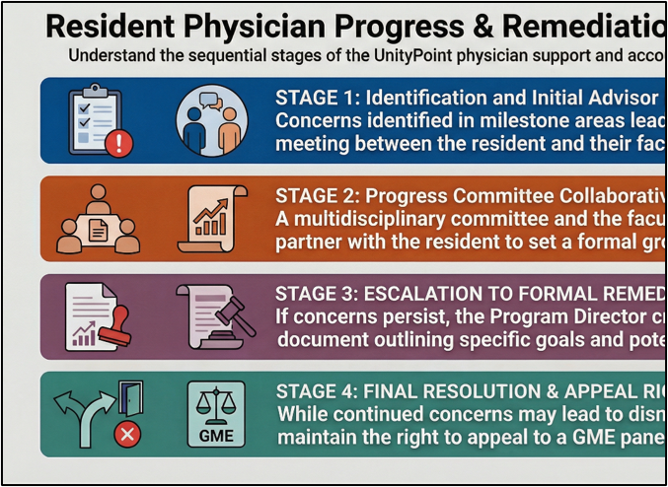
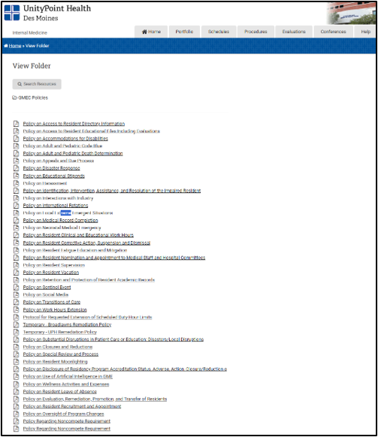
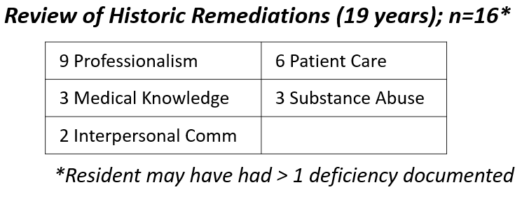

Results
IRB Exemption granted
Remediation Survey (#Faculty/#Resident) | Full Sample (n=81) | Faculty (n=37) | Residents (n=44)
Emergency Medicine (8/22) | 9 (11%) | 5 | 4
Family Medicine (14/24) | 11 (14%) | 6 | 5
General Surgery (21/22) | 11 (14%) | 7 | 4
Internal Medicine (7/34) | 16 (20%) | 5 | 11
Pediatrics (17/21) | 20 (25%) | 7 | 13
Podiatry (10/3) | 5 (6%) | 5 | 0
Psychiatry (8/17) | 8 (10%) | 2 | 6
Transitional Year (0/4) | 1 (1%) | 0 | 1
Review of program materials, resident surveys, historic data, policies, program director feedback

Slide 12
Discussion
Next Steps…
Get information/feedback from AIAMC participants
Update process documents
Have a resident focus group about process/documents
Finalize process/materials
Re-evaluate residents/program directors
Review future data
Report out at AIAMC annual meeting

Slide 13
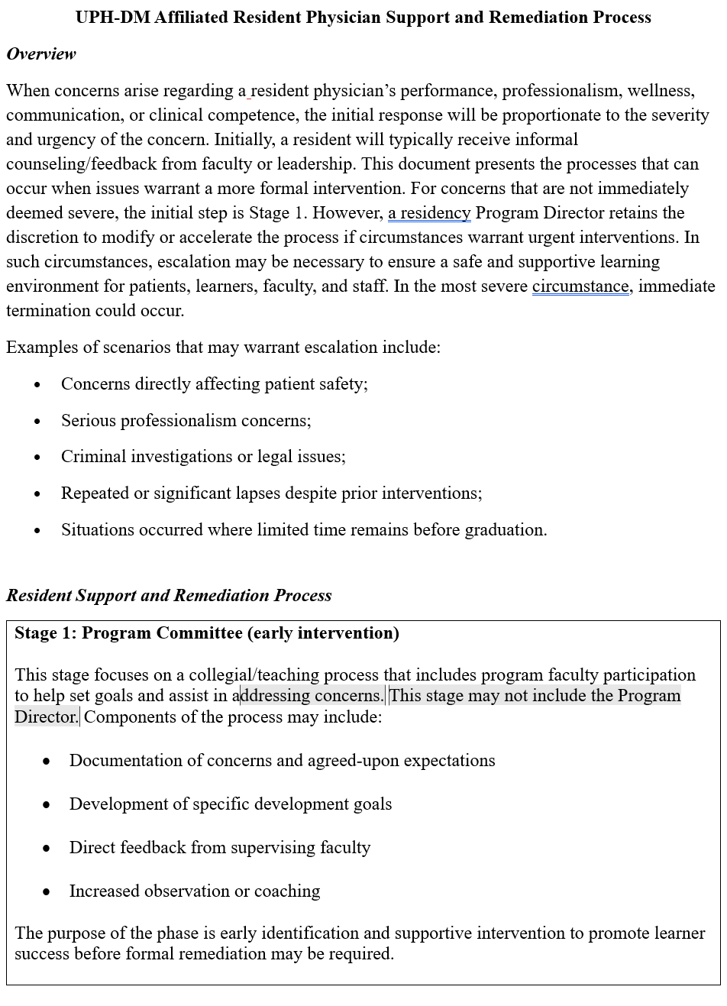
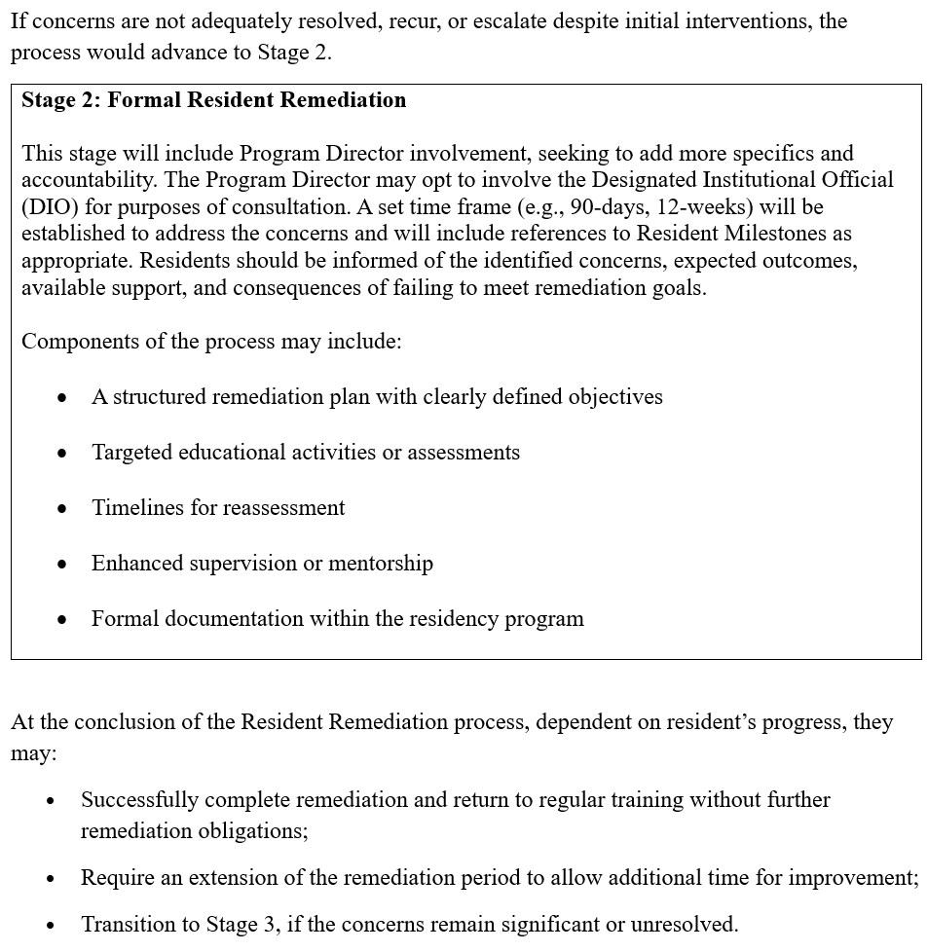
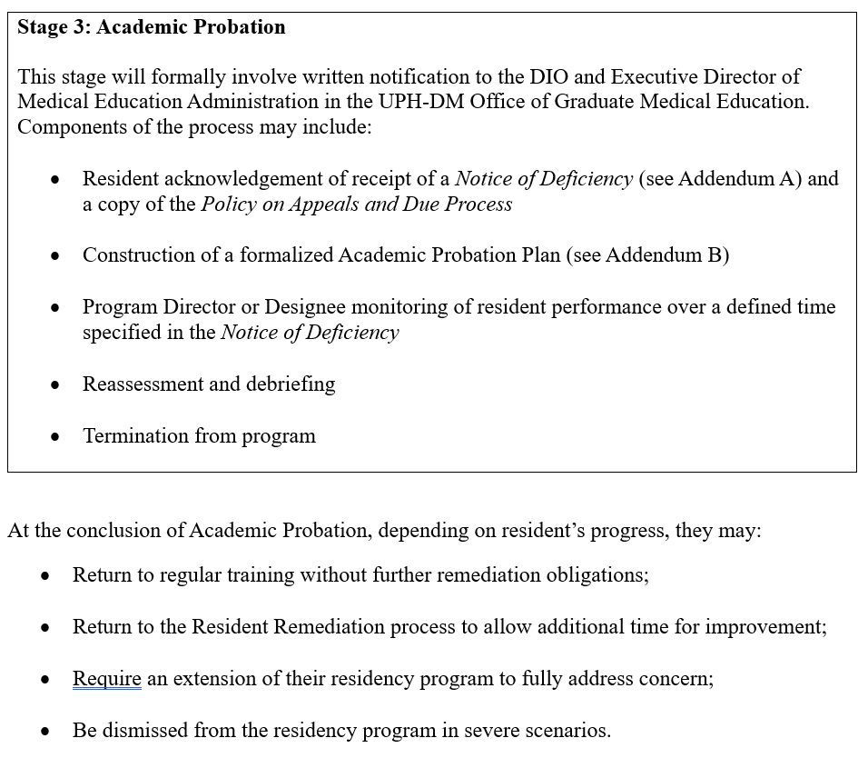
Current Formulated Process

Slide 14
OhioHealth (DUET)

Slide 15
Enhancing the Clinical Learning Environment
with DUET
AIAMC NI X Meeting Three Project Update
From feasibility to a measurement-ready next phase
Dual User Evaluation and Training (DUET) supports structured, AI-assisted reflection on ambulatory resident–faculty precepting interactions.
Clinical precepting
→
DUET analysis
→
Human debrief
Captured interaction
Structured feedback
Coaching and reflection
Matthew Johnston, DO
Notes:
[Sources]
DUET Meeting Three Storyboard.pptx, slide 1
AIAMC DUET Meeting 3 alternative template .pptx, slides 1–2

Slide 16
Aim, Objectives & Alignment
AIM
Improve precepting efficiency and effectiveness in an ambulatory FMP through AI generated feedback analysis.
1 | Understand the environment
2 | Strengthen precepting
3 | Improve the system
Assess resident and faculty perceptions of feedback, reflection, and the potential utility of AI-supported analysis.
Measure documented use of the One-Minute Preceptor (OMP) microskills and use findings to guide faculty development.
Evaluate whether DUET outputs are useful, fair, contextually valid, and practical within real clinical workflows to enhance the clinical learning environment.
Organizational alignment
Supports OhioHealth priorities in advanced technology, education, and feedback
Builds organizational experience implementing a novel AI agent within the system infrastructure
Augment a data-informed foundation for resident and faculty development
Notes:
[Sources]
AIAMC DUET Meeting 3 alternative template .pptx, slide 4
DUET Meeting Three Storyboard.pptx, slide 3

Slide 17
Introduction: Background & Context
Clinical challenge
Baseline need
Project focus
Ambulatory precepting must balance patient care, teaching, feedback, and multiple resident needs within limited time.
Pre-pilot surveys identified time as a recurring barrier. Faculty reported less consistent opportunities for reflection than residents reported for case-presentation reflection and debriefing.
Use DUET to strengthen the clinical learning environment by making feedback more structured, reviewable, and actionable without replacing human coaching.
Baseline learning-environment perceptions before Pilot #2 DUET use
Interpretation
Faculty reflection on precepting skills: 2/9 agreed (22%)
Faculty effective end-of-shift debriefing: 5/9 agreed (56%)
Resident reflection on case presentations: 7/8 agreed (88%)
Resident effective debriefing after encounters: 7/8 agreed (88%)
Faculty reported fewer consistent opportunities for reflection. Residents generally viewed the existing learning environment positively. These findings represent perceptions, not observed teaching performance.
Notes:
[Sources]
DUET Meeting Three Storyboard.pptx, slide 2
Faculty DUET use Pre-Survey(1-9).xlsx
Resident DUET use Pre-survey.xlsx

Slide 18
Interventions: Feedback-to-Improvement Cycle
1
2
3
4
Build
→
Integrate
→
Refine
→
Learn & adapt
DUET deployed within the OhioHealth Microsoft Copilot environment.
Workflow embedded in ambulatory precepting and simplified to reduce clicks and steps.
Prompts revised for linguistic fairness, shorter prioritized outputs, and OMT context.
Session feedback and output analysis drive iterative changes and faculty development.
Pilot #2 is the largest implementation so far , not the project endpoint.
The broader work now moves toward systematic measurement of usefulness, validity, fairness, debrief integration, and implementation of the first PDSA cycle focusing on enhancing faculty implementation of reinforcing positives from the OMP model during their precepting of cases.
Notes:
[Sources]
AIAMC DUET Meeting 3 alternative template .pptx, slide 6
DUET Meeting Three Storyboard.pptx, slide 6

Slide 19
Measures
Outcome measures
Process measures
Balancing measures
• Documented OMP microskill use
• Resident rating of AI-supported feedback utility
• Faculty rating of coaching support
• Output accuracy, usefulness, fairness, and contextual validity
• DUET use as a proportion of eligible precepting encounters
• Actual users relative to expected preceptors
• Successful-session rate
• Output completion and dashboard engagement
• Duration and workflow burden
• Faculty workload perception
• Resident cognitive load
• Technical reliability of the software/hardware used
• Risk of overinterpreting speech patterns or incomplete transcripts
Next measurement priority: add a brief, systematic rating of output accuracy and usefulness at the point of review.
Notes:
[Sources]
AIAMC DUET Meeting 3 alternative template .pptx, slide 5
DUET Meeting Three Storyboard.pptx, slide 4

Slide 20
Results: Early Session-Level Feedback
Resident session responses
Faculty session feedback
8 of 8
agreed AI-assisted debriefing enhanced their clinical education
14 of 17
responses indicated DUET served as a reminder of OMP microskills
More detailed analysis of presentations
Clearer learning points
Prompts to consider OMT when relevant
Guidance toward more concise presentations
Time remains a barrier to reviewing output together
Shorter and more prioritized outputs are preferred
Workflow simplification received favorable comments
Transcription Timeouts and mobile field issues can create frustration
Caution: ambient conversation with other staffing cases in the room may introduce unrelated content or contribute to missed details.
Anonymous session responses may include repeat participants; findings are descriptive.
Notes:
[Sources]
DUET Meeting Three Storyboard.pptx, slides 8 and 11
Faculty DUET Session Survey.xlsx
Resident DUET Session Survey(1-1).xlsx

Slide 21
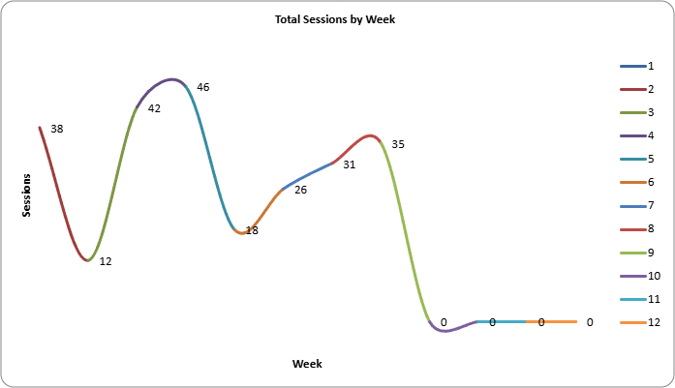
Results: Pilot #2 Utilization
Goal Utilization:
Current Utilization:
Utilization Range:
10%
17.5%
6%–39%
Of all clinic visits precepted with the agent
averaged across first 6 weeks of Pilot #2
Of clinic visits over the first 6 weeks of Pilot #2
What the data support
Adoption was reported as higher than Pilot #1, but utilization remained variable. Workflow simplification was followed by favorable faculty comments and increased utilization was reported.
What remains unresolved
Unique-user counts do not provide identification of user. Available data do not provide a complete weekly time series or support causal attribution.
Preferred future adoption metric: actual faculty users ÷ expected faculty preceptors for the relevant clinic period.
Notes:
[Sources]
DUET Meeting Three Storyboard.pptx, slide 7
User-provided Pilot #2 midpoint update

Slide 22
Results: OMP Microskill Use in Attending Outputs
Rated encounters: n=39
Across rated attending outputs, probing for supporting evidence and commitment were most consistently documented. Reinforcing positives was least documented.
Largest descriptive changes
Teach general rules: +34.6 points
Correct mistakes: +28.2 points
Commitment: −23.1 points
Probe evidence: −19.2 points
Interpret cautiously: only 39 of 141 logged outputs contained extractable rated data; no September ratings were available, and documented output is not equivalent to all teaching that occurred.
Notes:
[Sources]
DUET Meeting Three Storyboard.pptx, slide 9
Initial JSON output analysis supplied for Meeting Three storyboard

Slide 23
Barriers & Strategies
Barrier / limitation
Response strategy
Status
Time for joint debriefing
Integrate review into existing precepting workflow
Ongoing
Variable adoption
Target limited users; use expected-preceptor denominator
Ongoing
Excessive workflow steps
Simplified workflow effective 8/21/26
Implemented
Speech patterns overinterpreted
Fairness safeguards updated 8/17/26
Monitor
No objective accuracy measure
Add one-click accuracy/usefulness rating
Next
Outputs not organized longitudinally
Finalize dashboard, storage, access, and analytics
In progress
Technical and mobile issues
Address timeouts and field pre-population
Next
The strategy for the next phase is to close measurement and reliability gaps before considering broader implementation.
Notes:
[Sources]
DUET Meeting Three Storyboard.pptx, slide 10
Faculty and resident session surveys
User-provided implementation dates

Slide 24
Discussion & Next Steps
CURRENT ASSESSMENT: PROMISING EARLY SIGNALS, BUT NOT YET READY TO SCALE
Measure validity
Implement brief accuracy, usefulness, and contextual-validity ratings.
1
Normalize adoption
Use eligible encounters and expected preceptors as denominators.
2
Strengthen the dataset
Improve storage, extractability, longitudinal organization, and rated-output capture.
3
Test equity safeguards
Monitor linguistic fairness and distinguish transcript limitations from absent teaching: improving.
4
Define readiness
Set explicit criteria for reliability, value, workflow fit, and expansion.
5
Early read: survey data suggests the program is achieving one project aim — residents report an enhanced CLE experience.
Faculty views are more mixed, mainly due to time constraints on reviewing feedback and resident output; improving as workflows streamline and shortages resolve.
Notes:
[Sources]
DUET Meeting Three Storyboard.pptx, slide 11
AIAMC DUET Meeting 3 alternative template .pptx, slide 9

Slide 25
Cleveland Clinic

Slide 26

Improving Code Blue Performance: Changes in Internal Medicine Resident Confidence and Safety Event Metrics After an Educational Algorithm
Samuel Wiles, MD; Cheryl Goliath, PhD; Jeffrey Solomon, MD; Trisha Kick, RN, EMT-P; Annie Johnson, RN, MEDSURG-BC; Adina Brett-Morris, PhD; FNU Anamika, MD; Sakshi Dixit, MD
Introduction: Background & Context
Cleveland Clinic Akron General(CCAG) Internal Medicine[IM] residents have less exposure to leading code blue events and lack confidence in leading resuscitations
Simulation training improves confidence and skills
Simulation also helps identify and prevent latent safety threats[LST]
Aims/Objectives/Alignment
1. To increase comfort levels among IM residents at CCAG involved in code blue events.
2. To increase the medical knowledge of CCAG IM residents in the management of code blue scenarios.
3. To identify and decrease LST events in IM inpatient floors.
4. To improve the safety events reporting process in the IM department at CCAG.

Slide 27
Measures
Comparing pre and post confidence levels (Figure 1) and medical knowledge assessment scores (Figure 2).
In situ simulation used the ACLS algorithm, and Get with the Guideline’s QI Improvement metrics
Comparing LST reported in SERS 9 months pre-intervention vs intervention period
Confidence scores on a 5-point Likert scale- Paired t-test or Wilcoxon for data analysis using SPSS
AIAMC Project Pre-survey Questions
Confidence scale:
1 = Not at all confident | 2 = Slightly confident | 3 = Moderately confident | 4 = Very confident | 5 = Extremely confident
Overall confidence in your ability to manage a cardiopulmonary arrest: ___
Confidence in your ability to perform chest compressions: ___
Confidence in your ability to manage an airway: ___
Confidence in your ability to recognize and treat different arrhythmias: ___
Confidence in your ability to administer emergency medications: ___
Confidence in your ability to communicate clearly with your team during a code: ___
Confidence in understanding your role during a code: ___
Confidence in the ability of the team to work together effectively: ___
Familiarity with the location of the crash cart: ___
Familiarity with the supplies inside the crash cart: ___
AIAMC Code Blue Medical Knowledge Questionnaire
What is the first step when you find an unresponsive adult?
A. Check for a pulse B. Start chest compressions C. Assess breathing and pulse D. Defibrillate
What is the correct chest compression rate for high-quality CPR?
A. 80–100/min B. 100–120/min C. 120–150/min D. >150/min
What is the recommended compression depth for an adult?
A. 2–2.5 inches B. 1.5–2 inches C. At least 2 inches (5 cm) D. 2.5–3 inches
Which rhythm is shockable in cardiac arrest?
A. Pulseless VT B. Asystole C. VF D. Torsades de pointes
What is the recommended dose of epinephrine during cardiac arrest?
A. 1 mg every 1–2 minutes B. 1 mg every 3–5 minutes C. 3 mg every 3–5 minutes D. 5 mg every 5 minutes
After 2 minutes of CPR, what should be assessed during the next rhythm check?
A. Spontaneous circulation B. A shockable rhythm C. Pulse D. Appropriate ventilation
A patient has a pulse but poor respiratory effort and is becoming increasingly confused. The next step is:
A. Epinephrine B. Intubation C. Respiratory support D. Magnesium
Epinephrine helps in cardiac arrest by:
A. Increasing cardiac contraction B. Increasing peripheral vasoconstriction C. Decreasing heart rate D. Sodium bicarbonate
Which of the following is an indication for synchronized cardioversion?
A. Asystole B. Ventricular VF C. SVT D. PEA
The recommended starting dose for synchronized cardioversion of unstable SVT is:
A. 20 J B. 50–100 J C. 100 J D. 200 J
Figure 1. Pre-Survey Questions
Figure 2. Medical Knowledge Questionnaire

Slide 28
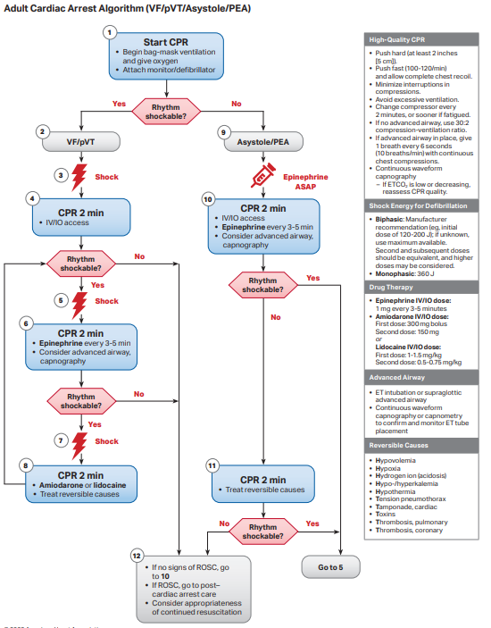
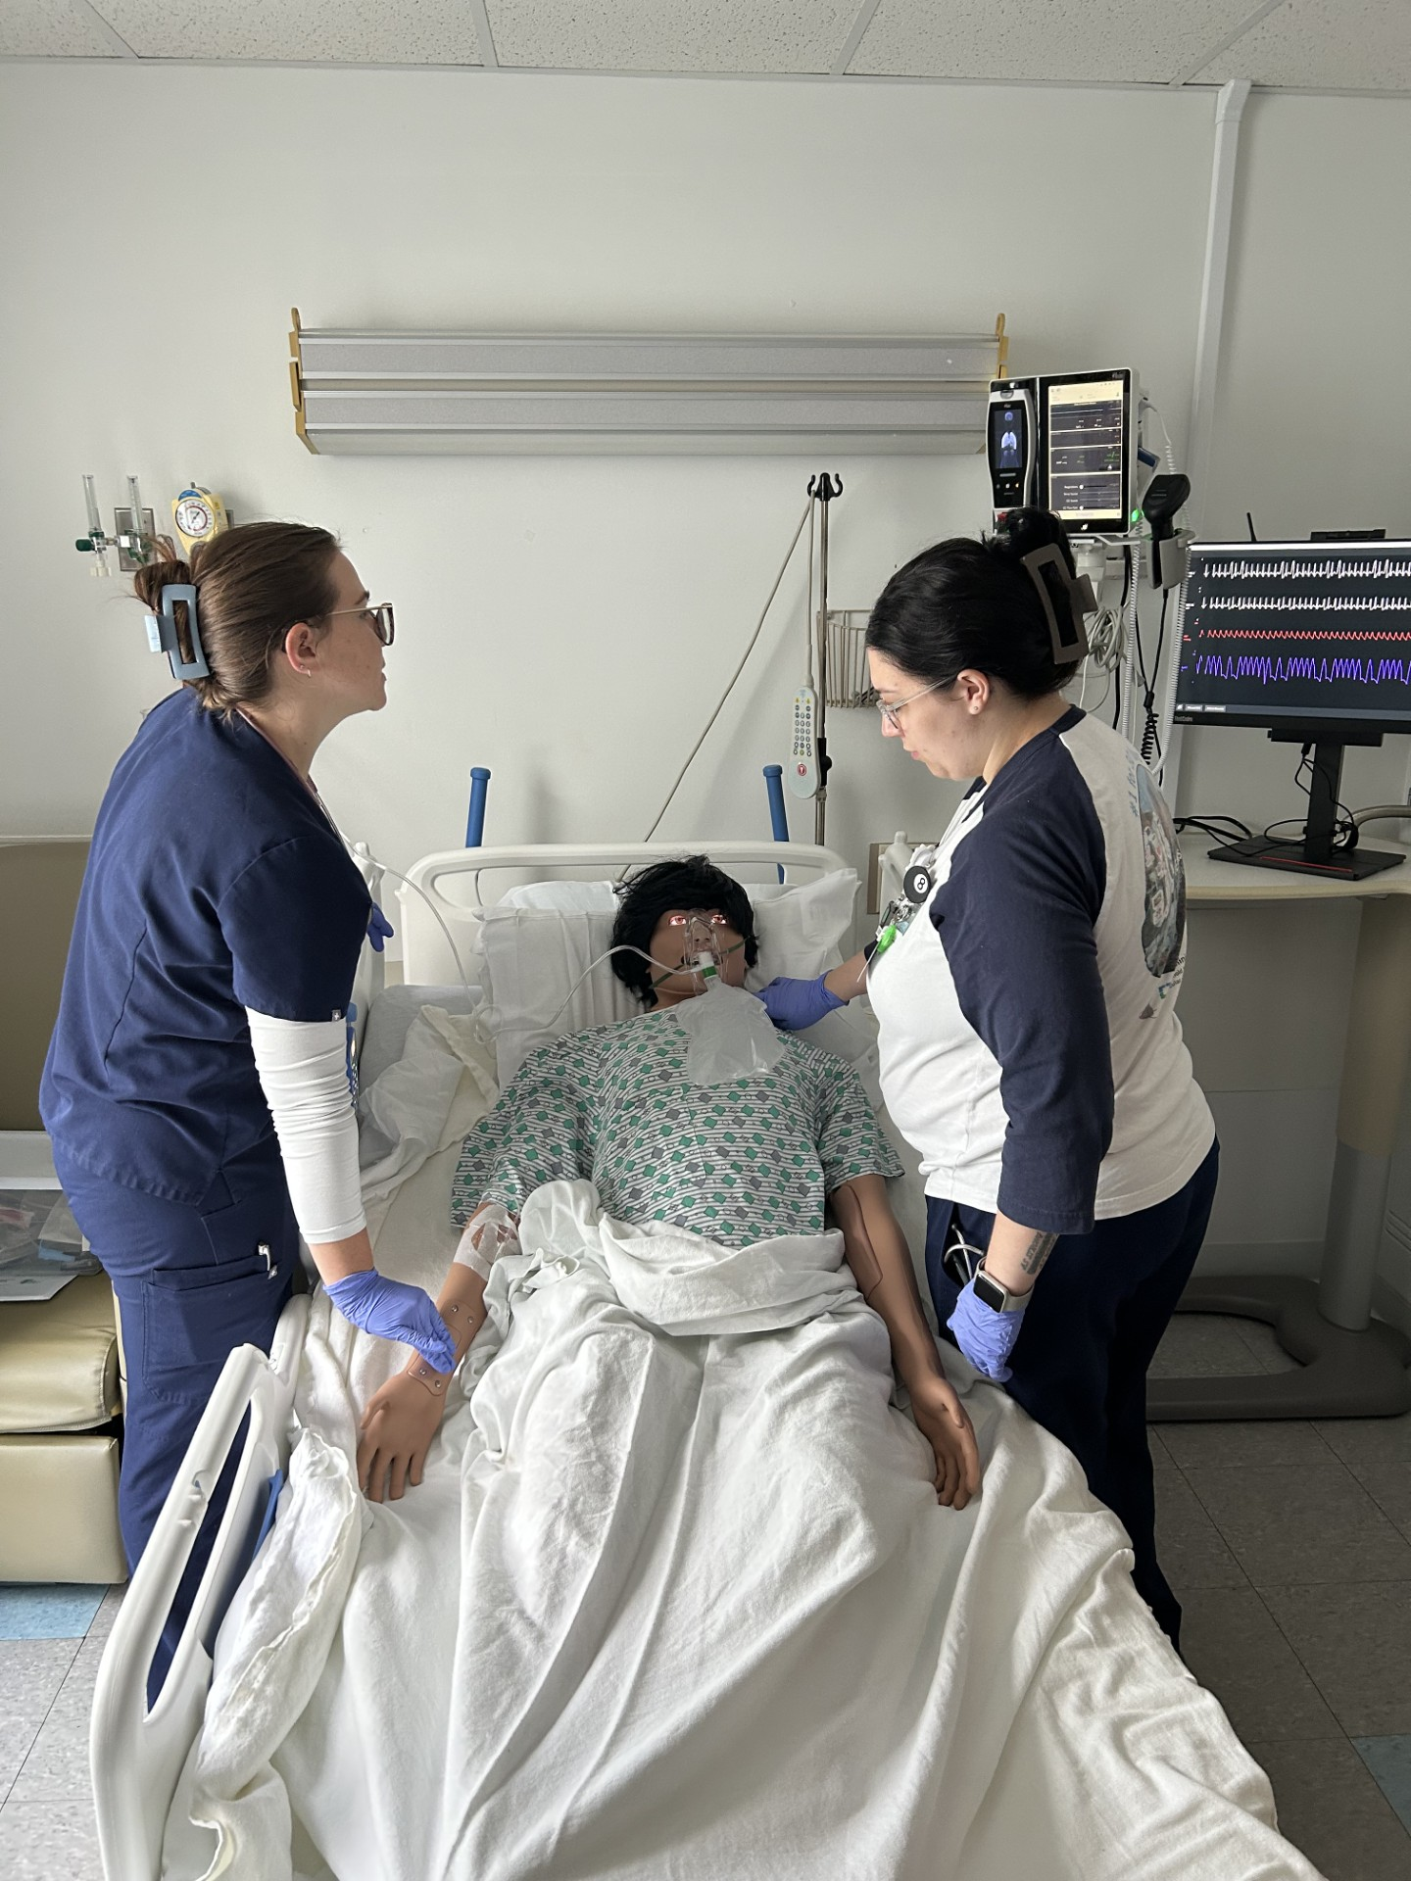
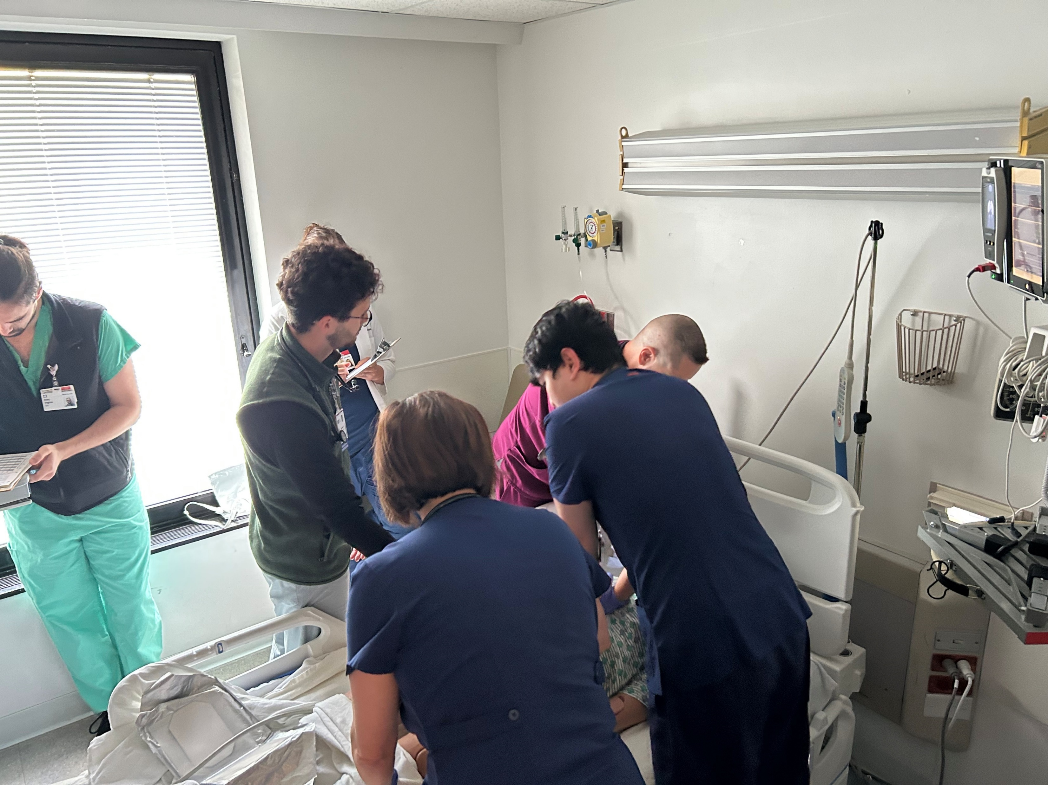
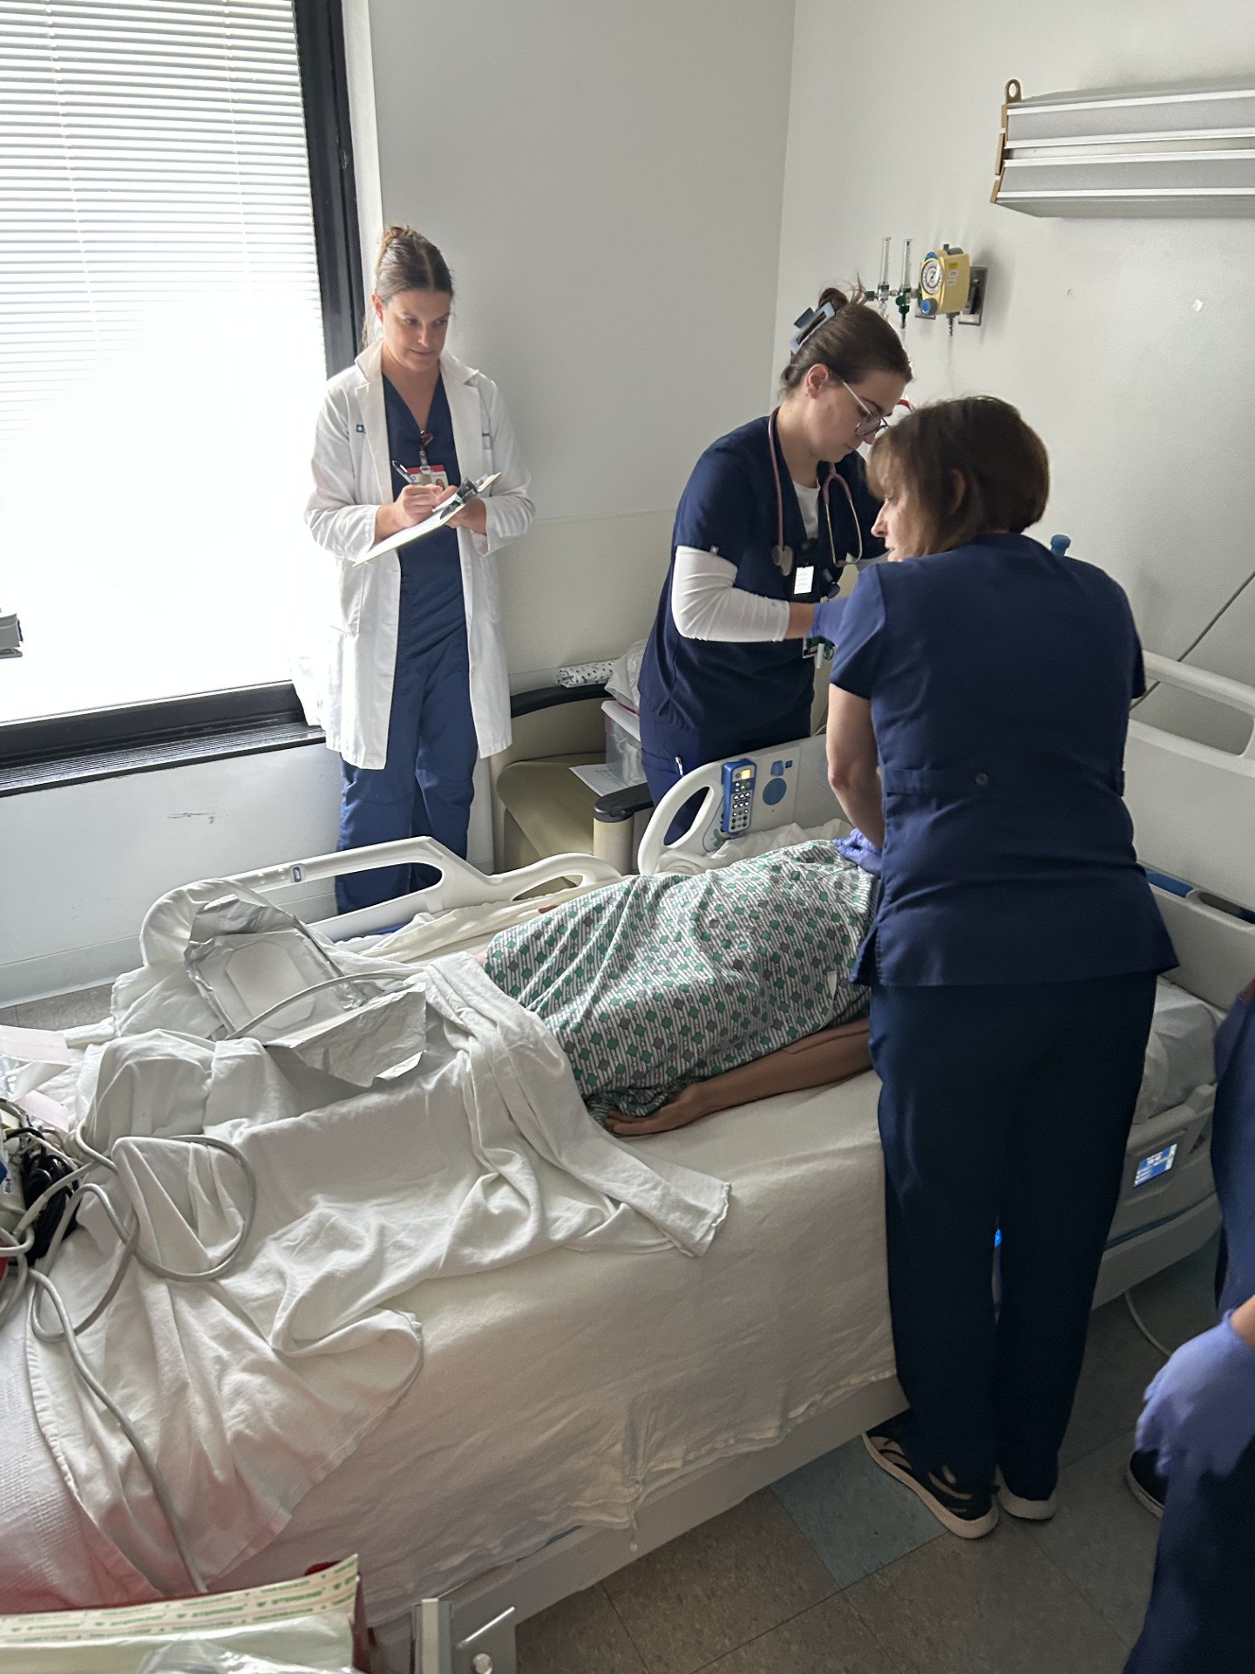
Interventions/Changes
Structured simulation-based mock training session from February 2026 to November 2026.
8 mock codes have been conducted so far.
5-8 residents per session, one assigned as a leader
One time 15-minure teaching lecture on algorithms was given(Figure 3)
Each code was attended by 2-4 residents(Figure 4)
Pre- and post surveys assessed resident’s confidence and medical knowledge
This quality improvement project was approved by the Cleveland Clinic Simulation and Advance and skills Center
Figure 3: Cardiac arrest algorithm
Figure 4: Mock codes

Slide 29
Barriers & Strategies
Staffing and workload: Staff caring for real patients and unable to stepping away for a simulation.
Limited participation: Not all members of the interprofessional team may be available, including nurses, physicians, respiratory therapists, pharmacists, and support staff.
Scheduling: Finding a time that works across shifts, departments, and disciplines was challenging for the facilitators to meet the number of Codes per month.
Fear of judgment: Hard to get one of the residents in some cases to take the lead role in the Mock Code.
Unfamiliarity with the simulation: In the beginning the staff had difficulty treating a Mock Code as a learning exercise rather than a real emergency.
Technical problems: Issues with calling the Code Blue overhead.
Unexpected events: The patient phone was ringing during a Mock Code looking for the previous patient.

Slide 30
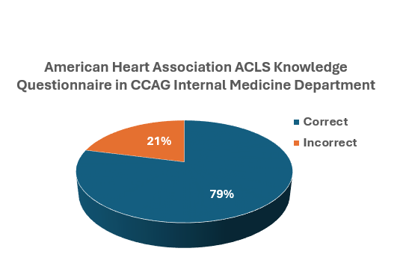
Results
34 out of 41 IM residents filled the medical knowledge questionnaire with an average score of 79% correct
Figure 5. Medical Questionnaire Results

Slide 31
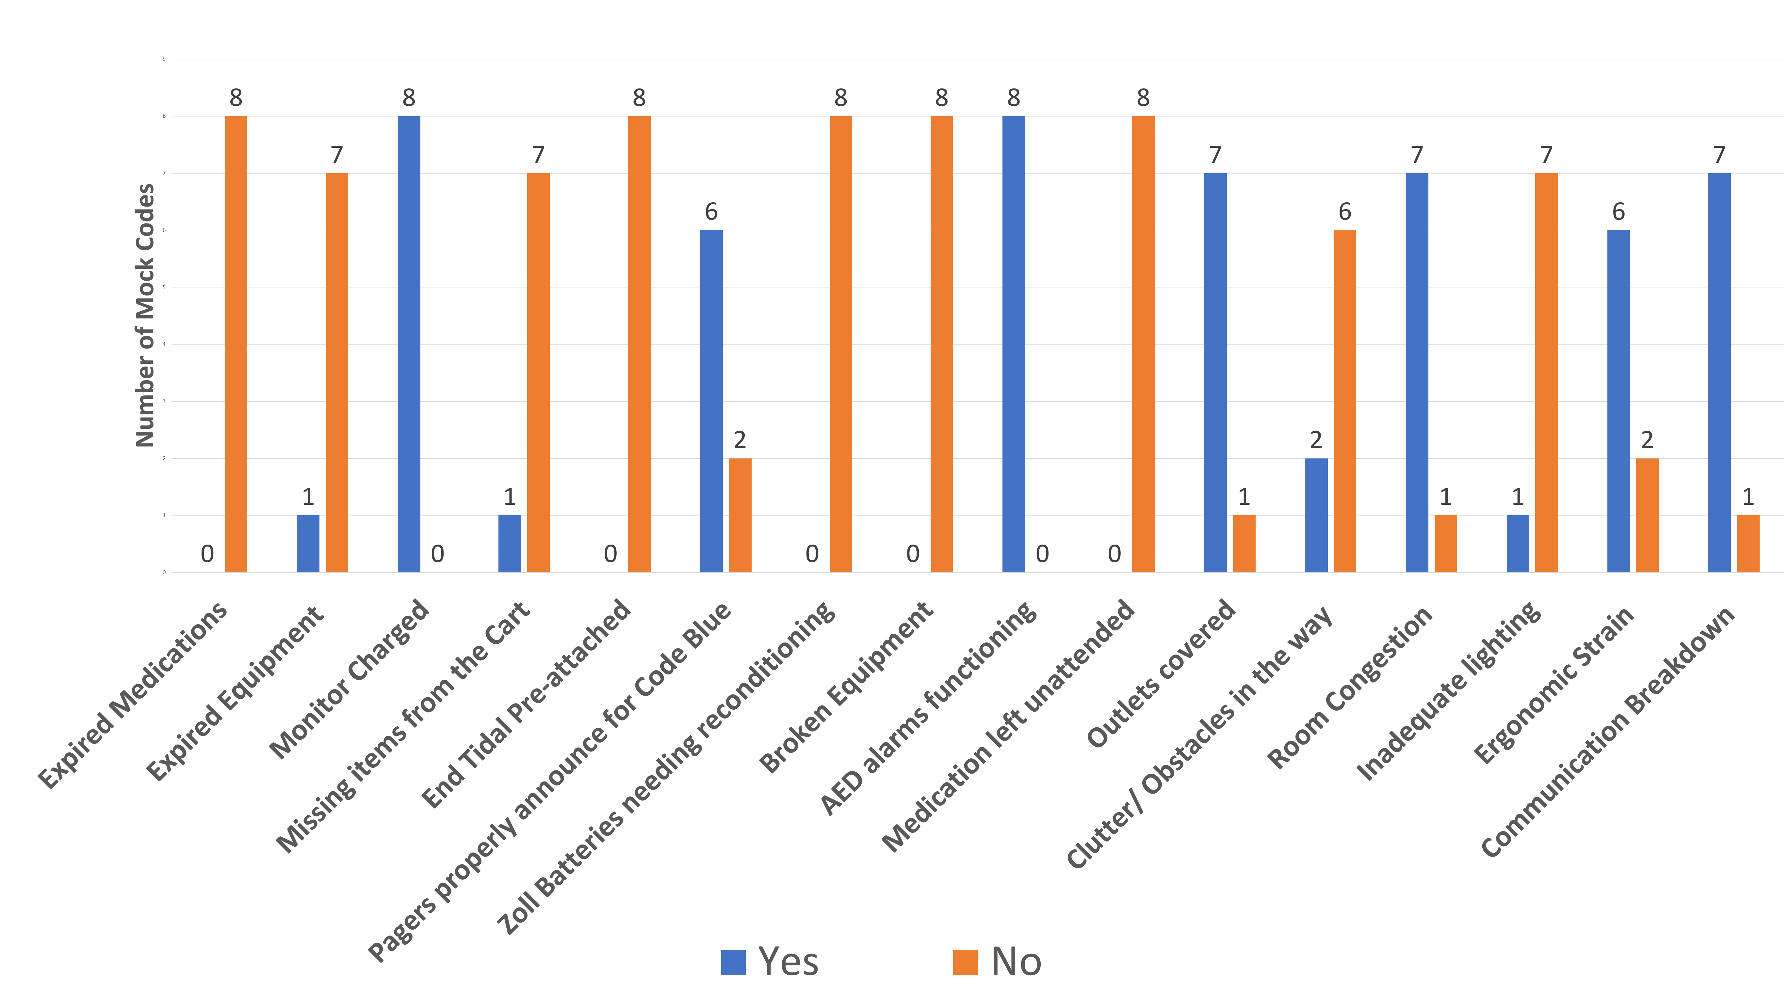
Results [cont.]
Latent Safety Threats

Slide 32
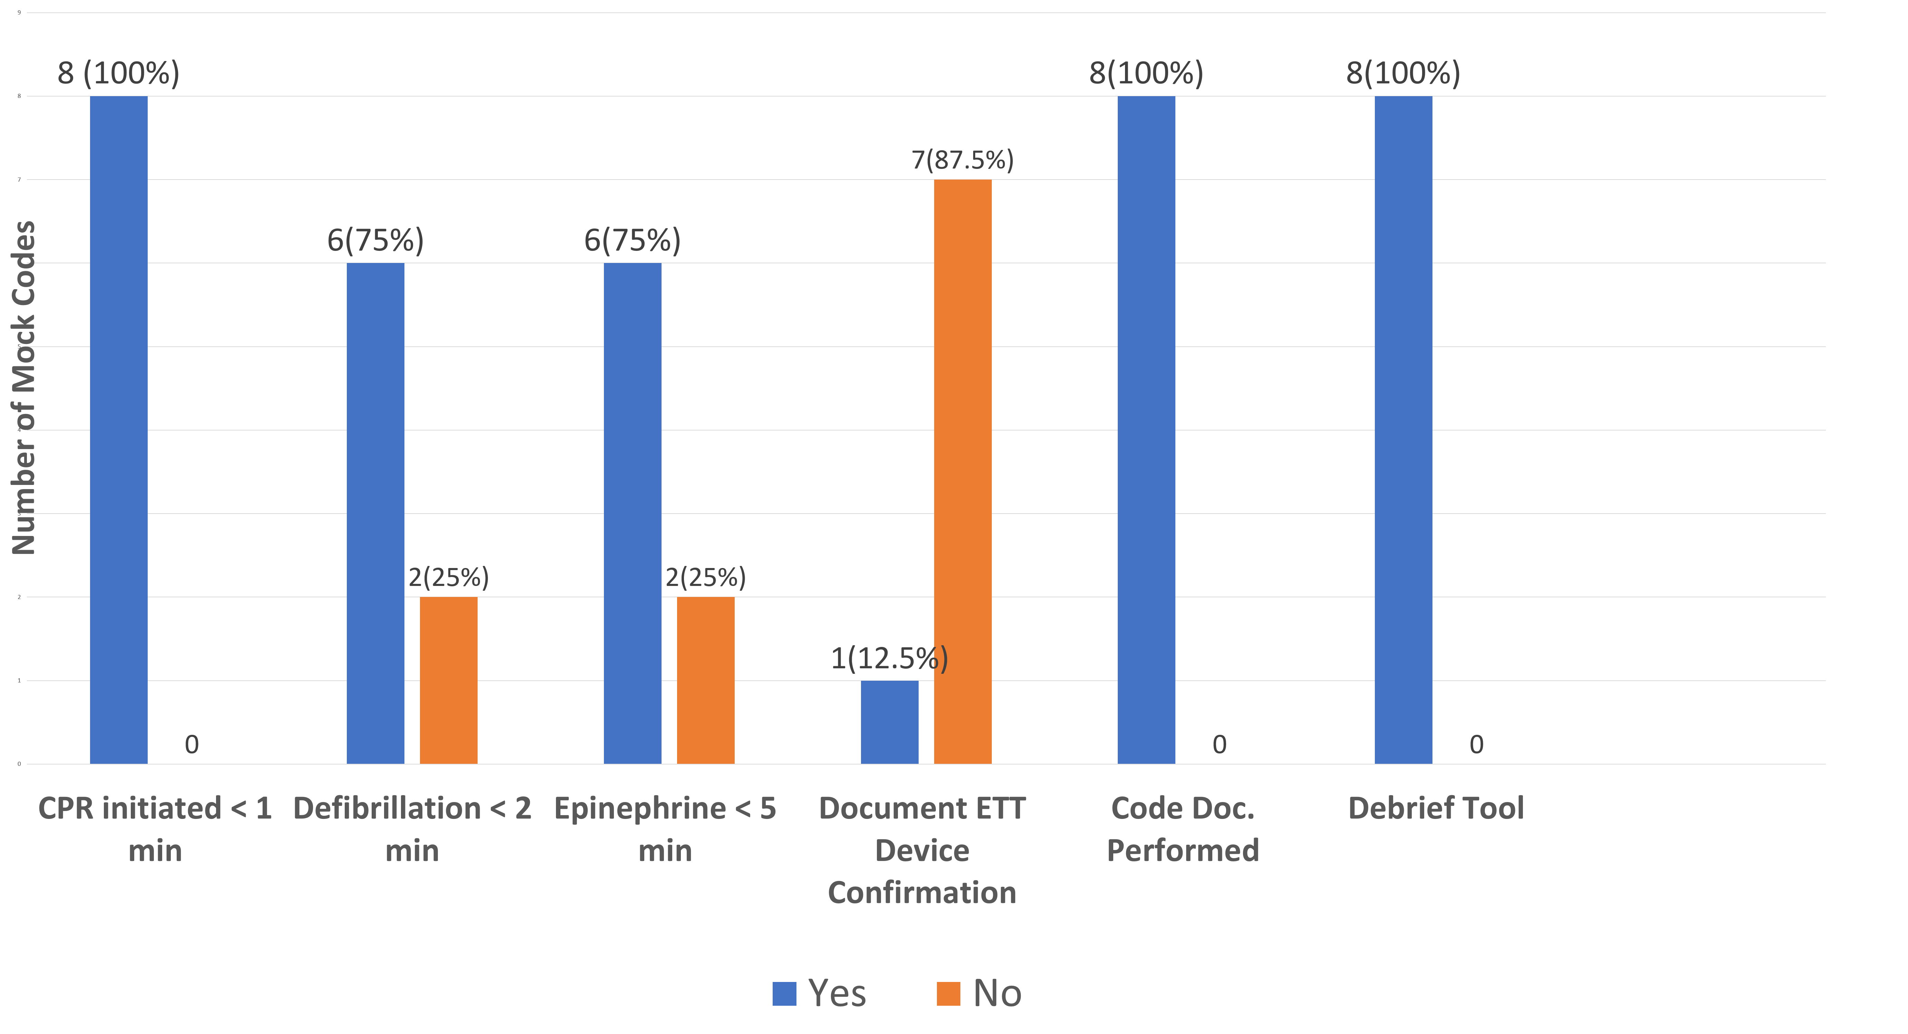
Results [cont.]
Resuscitation Simulation in situ Metrics

Slide 33
Discussion
Simulation training: Provided a safe, standardized environment to practice ACLS, leadership, teamwork, and communication.
ACLS knowledge: Overall performance was strong, with 79% correct responses.
CPR performance: CPR was initiated within 1 minute in 100% of mock codes.
Code processes: Documentation and debriefing were completed in 100% of simulations.
Time-sensitive interventions: Timely defibrillation and epinephrine occurred in 75% of simulations.
Key gap: ETCO₂/device confirmation was documented in only 12.5%, highlighting an important education opportunity.
Safety threats: Simulations identified issues with equipment, environment, ergonomics, and communication.
Next steps: Future PDSA cycles will address these gaps through targeted education, system changes, and repeat simulations.

Slide 34
Aurora Health Care
(Professionalism)

Slide 35



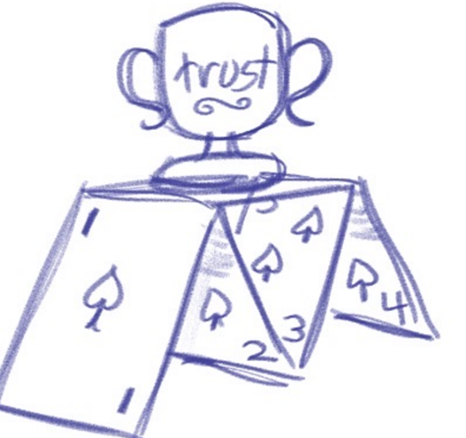
Introduction: Background & Context
Structured Discussions About Professionalism As Trust
D Simpson PhD; T La Fratta MBA; K Ouweneel MBA; K Agard CMP, PMP; Delfinado MD; S Caudle MD; W Lehmann MD, MPH; N Salvo MD; E Santana C-TAGME; J Bidwell MD; J O’Brien MD;
W MacDonald MD; D Irby MDiv, PhD; Hazel Bidwell, BA
Unprofessional behavior¹⁻³
  Adversely affects patient care, team functioning, communication and actor’s professional growth
Entrusted Professional Activities (EPAs) & Trust
  Trust = willingness to being vulnerable to actions of another
  Variables associated with entrustment decisions⁴ parallel dimensions of trust⁵⁻⁶ = (un)professionalism behaviors
    Care, Sincerity, Reliability, Competence (with Humility)
Comics – Graphic Medicine in Med Ed⁷⁻¹⁰
  Increasing used for array of topics
  Outcomes Include:
    Enhances empathy, effective communication & self reflection
    Makes tacit knowledge (hidden curriculum) visible
    Breaks down biases
    Deconstruct medical hierarchy (psych safety)
Selected References
Cooper WO, et al. Physician specialty differences in unprofessional behaviors observed & reported by coworkers. JAMA Network Open. 2024 3;7(6):e2415331-.
Ehmann MR, Murano T, Sullivan C, Egan DJ, Nazario S, Regan L. Remediation methods 2.0 for Professionalism and Interpersonal and Communication Skills Milestones: an update. J Grad Med Educ. 2024;16(2):128-132. DOI: http://dx.doi.org/10.4300/JGME-D-23-00536.1
Chen JX, Mylod D, Jing Y, et al. Trainee-Physician Milestones Ratings and Patient Experience Surveys in Early Unsupervised Practice. JAMA Netw Open. 2025;8(10):e2536380. doi:10.1001/jamanetworkopen.2025.36380
Ten Cate O, Chen HC. The ingredients of a rich entrustment decision. Medical teacher. 2020 Dec 1;42(12):1413-20.
Hamilton AL, Layden EA, et al. Definition, Measurement, Precursors, and Outcomes of Trust Within Health Care Teams: A Scoping Review. Academic Medicine. 2024 Jan 1;99(1):106-17.
Feltman C. The thin book of trust: An essential primer for building trust at work. Berrett-Koehler Publishers; 2024 Sep 10.
Consorti F, Fiorucci S, Martucci G, Lai S. Graphic novels and comics in undergraduate and graduate medical students education: a scoping review. European Journal of Investigation in Health, Psychology and Education. 2023 Oct 16;13(10):2262-75.
Scavarda A, Moretti V, et al. The creative doctor: exploring the role of comics-enhanced education in medical professionalism. Advances in Health Sciences Education. 2026 Jul 17:1-22.
Moretti V, Rewey SJ, Green MJ. Visual Attunement: A Longitudinal Study of Comics-Based Education in a US Medical School. Teaching and Learning in Medicine. 2026 Jun 6:1-4.
Ronan LK, Czerwiec MK. A novel graphic medicine curriculum for resident physicians…through comics. J of Medical Humanities. 2020 Dec;41(4):573-8.

Slide 36
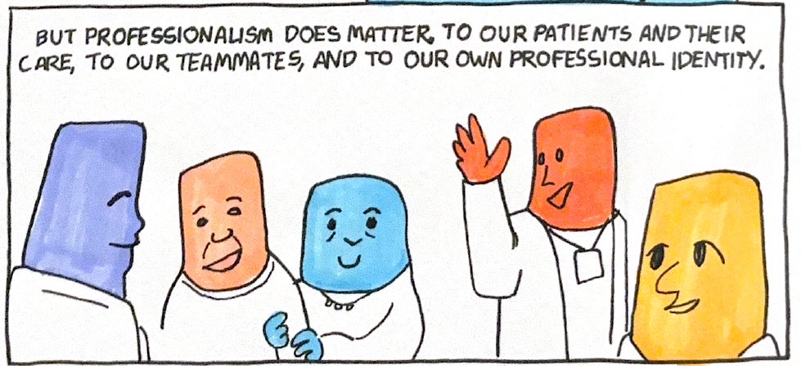
Aim/Objectives/Alignment
Aim: To reframe the ability to analyze and discuss professional behavior as enTRUSTment focusing on consequences of adverse behaviors on patient care, teamwork, and one’s own growth and development
Align: Culture of Safety & Work Environment Survey
Building on AH’s 2024 focus on psychological safety, in 2026 shifting to strengthening trust as “trust sustains our work relationships over time” → team level action plans

Slide 37
Measures
Interactive/Facilitated Session Attendee’s Evaluation
Resident Evaluation of Teaching Pre-Post
  Demonstrated respect for me as a trainee
  Promotes and champions PROFESSIONALISM (Treats colleagues with, courtesy/respect; high integrity; accountable for actions…)
ACGME Resident/Fellows Survey – Professionalism
Professionalism Milestones
ACGME Faculty Survey
Culture of Safety and Work Environment Survey
# Professionalism Concern Cards in Med Hub
  Ob/Gyn & Fam Med already submit

Slide 38
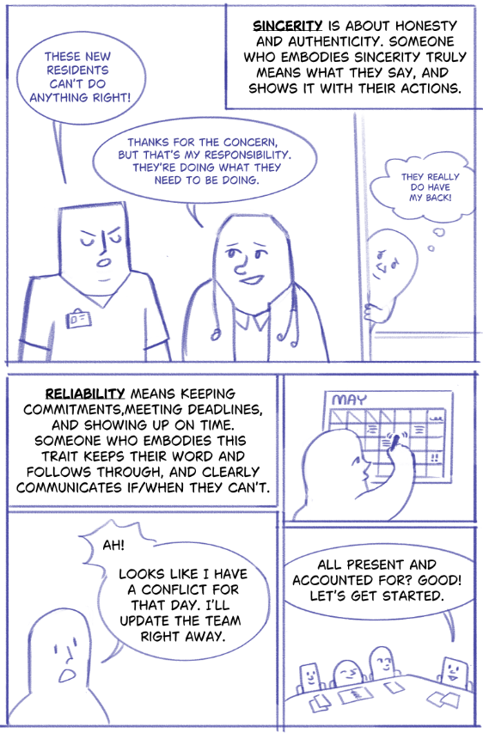
Interventions | Changes
30-90 Minute Interactive/Facilitated Discussions
  10-20 min: Background including evidence re: adverse effects of unprofessional behavior
  30-45 min: Facilitated sm group discussions
    Presented needs assessment survey behavior
    1/3 of group assigned to list adverse effects
    Debriefed with quick poll
    Shown needs assessment data - surprised?
    Repeat with another behavior
  10-15 min: Lg group debrief & quick evaluation
Comic Educational Novelette
  To replace 10-20 min PP background presentation with more engaging educational intervention
  Work group collaborated with comic artist > medicine
  <20-page block –head style comic

Slide 39
Barriers Strategies
Minimal barriers – Facilitators leading session didn’t all have face to face meetings or experience with this session prior to facilitating
Utilized emails, minutes, transcripts, instructors guide and a training video for facilitators

Slide 40
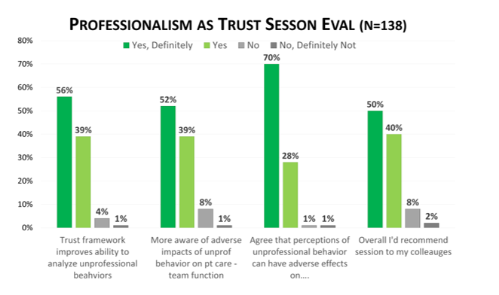
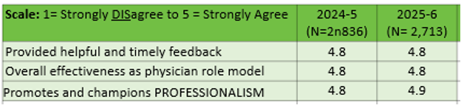
Results
7 Interactive/Facilitated Discussions
  2 GME Retreats
  2 Shared Noon Conferences
  1 Program Session
  1 TRIUMPH Medical Student Session
  2 Regional/National
ACGME Resident Survey 2024-2025 vs 2025-2026
  6% Residents/Fellows encouraged to feel comfortable calling supervisor with questions
  1% Faculty act professionally when teaching
  1% Faculty act professionally when providing care
Aurora Clinical Teaching Evaluation of Faculty
Professionalism Milestones Rating
  Modest change – 0.1 – 0.3 from 2024-2025 to 2025-2026
Notes:
Notes: significant ACGME survey increase in certain programs such as Radiology

Slide 41
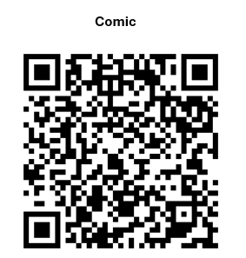

Discussion
Next Steps
Host interactive discussions with comic
Consider 2nd session on insight
Train-the-Trainers
Pre-Post Data analysis
Areas Seeking Guidance
How to measure/evaluate comic (utility/value)
Dissemination beyond medical education

Slide 42
Kaiser Permanente

Slide 43

Integration of Social Determinants of Health Tools and AI Support in the Resident Clinic
Lucy Martinez, MD | Kyle Snook, DO | Brooke Harris, PhD | Michelle Loaiza, MSHCA | Theresa Acevedo-Rousso, MPA
Kaiser Permanente Northern California Undergraduate and Graduate Medical Education
Introduction: Background & Context
Social Determinants of Health (SDOH) significantly shape health outcomes, yet inconsistent screening in our clinic leaves social needs unmet—contributing to preventable acute care use, poor chronic disease control, and health inequities. Limited visit time, competing priorities, and data integration challenges create barriers. For residents, this limits training in social context and resource navigation. AI tools could identify SDOH in real time and prompt tailored referrals, enhancing both care delivery and education.
Kaiser Permanente is already implementing use of ambient documentation tools (Abridge) during physician clinic visits, as well as screening patients for SDOH via secure messaging. However, these are not being used together. The capabilities of Abridge have been extended and improved significantly since our last meeting to include the ability to enter prompts and real-time interaction with AI during the visit.

Slide 44
Aim/Objectives/Alignment
We aim to integrate a targeted prompt that residents can enter into Abridge to assist residents in identifying and addressing SDOH. This prompt will identify areas of need from the patient/physician conversation with the goal of utilizing the patient’s zipcode to suggest resources for that need, that physicians can then share with patients. This aligns with our organization by:
    Integrating SDOH into care and training
    Creating a unified workflow for social needs
    Using existing ambient AI tools to enhance learning and streamline care
We will introduce this workflow/prompt to our third-year residents and request that they utilize the prompt for 1 visit during each clinic half day over the next 8 weeks and will then reassess. We aim to:
    Increase resident knowledge of SDOH domains and how to address them
    Increase resident confidence in assessing for SDOH
    Increase patient referrals to SDOH resources

Slide 45
Measures
SDOH screening completion rate and proportion of visits with documented SDOH in the EHR
      Pull from smartphrase added to prompt
Positive screens addressed and referral rates to community/social resources for identified needs
      Pull from smartphrase added to prompt
Resident pre/post survey scores on confidence, knowledge, and perceptions of the SDOH learning environment
Time spent on note/visit and/or resident burden
Identification of continued SDOH learning opportunities
Notes:
Time spent on note/visit and/or resident burden is balance measure

Slide 46
Interventions/Changes
A short teaching session at kickoff that covers workflow, including prompt and SDOH tool
 | Prompt
TASK 1 IDENTIFY SOCIAL NEEDS | During visit, review the visit conversation and the patient’s SDOH questionnaire if available. If none, state “No questionnaire on file.” identify evidence of need in these domains (listed in final slide): For each domain where a need is identified, report: Domain Source: "Questionnaire," "Conversation," or "Both" Supporting evidence: a brief quote or paraphrase of what was said or answered Patient-stated priority or interest in help, if expressed (e.g., "declined resources," "wants help with food first") Flag positive questionnaire items not discussed in the visit Only report needs supported by the questionnaire or conversation. Do not infer needs from demographics, diagnoses, insurance type, or neighborhood.
TASK 2 – RESOURCES | For each identified need, suggest: The TYPE of resource that addresses it Resources located near patient’s zipcode that may address this need from established programs and verified resources (e.g. 211, SNAP, WIC, KP Community Support Hub, findhelp.org searched by zipcode)
TASK 3 - DOCUMENTATION | Draft a brief SDOH section for the note summarizing identified needs, patient preferences, and the plan (referrals made, resources given, follow-up). Suggest whether a referral to social work or a care manager is indicated
TASK 4 – TEACHING POINT | Provide one brief (2–3 sentence) teaching point, such as an unaddressed positive screen, a missed opportunity to ask a follow-up question, or how an identified social need may affect the patient's treatment plan (e.g., medication cost, diet recommendations with food insecurity, follow-up with transportation barriers)
FORMAT | Use short headers and bullets. Include “SDOHAI” at beginning of note. Keep the total output concise enough to review in under 2 minutes. All suggestions are for clinician review and must be verified before being shared with the patient.

Slide 47
Barriers & Strategies
Incomplete SDOH data from KP questionnaire
AI concerns (e.g. hallucinations)
Time constraints resulting in lack of implementation or declining use over time
Small sample size

Slide 48
Results
PDSA #1
(Resident Survey)
Discussion with stakeholders
Expansion of Abridge
PDSA #2
PGY3s
PDSA #3+
PGY2s
Mar/Apr 2026
Baseline &
Feedback
Jun/Jul 2026
Aug/Sept 2026
Oct/Nov 2026
Dec-Mar 2026
Notes:
Talk about how your meeting with stakeholders did not really go anywhere, but thankfully things got expanded and we were able to test prompts ourselves individually

Slide 49
Discussion
Critical Next Steps
Run PDSA cycle with third year residents to test workflow in small cohort
Refine to expand to additional classes – PGY2s
    First years have restricted Abridge use
Current challenges
Consider Z-codes to help with pulling data
Tracking referrals
Adjusting workflows that fit time constraints based on feedback from trial
Creating practical SDOH training for faculty and resident to help integrate into precepting and encourage more successful use
Guevara M, Chen S, Thomas S, et al. Large language models to identify social determinants of health in electronic health records. NPJ Digit Med. 2024;7(1):6. Published 2024 Jan 11. doi:10.1038/s41746-023-00970-0
National Academies of Sciences, Engineering, and Medicine; Health and Medicine Division; Board on Health Care Services; Committee on Integrating Social Needs Care into the Delivery of Health Care to Improve the Nation's Health. Integrating Social Care into the Delivery of Health Care: Moving Upstream to Improve the Nation's Health. Washington (DC): National Academies Press (US); September 25, 2019.
Notes:
PDSA will test whether to adopt, adapt or abandon
Current challenges: first two are concerns as they would introduce increased burden on resident, also considered having them fill form after each use but that would again add more burden

Slide 50
Appendix: SDOH Domains Assessed
Food insecurity
Housing instability or poor housing quality
Transportation barriers (including to appointments or pharmacy)
Utilities (difficulty paying for electric, gas, water, phone)
Financial strain, including cost-related medication nonadherence
Employment / income
Health insurance or benefits gaps
Interpersonal safety
Social isolation / caregiver strain
Childcare or dependent care
Health literacy, language, or digital access barriers
Legal needs (e.g., eviction, immigration-neutral legal aid, benefits appeals)

Slide 51
RWJBH Monmouth Medical Center

Slide 52


Improving Clinical Performance Through a
Resident-Facing EPIC Dashboard
THE OPPORTUNITY
Joseph Jaeger, DrPH, MPH • Christine Steinberger, MHI • Kyle Clancy, BA
Francesca Ferrari, MHA • Noel Weber, MD
Turn fragmented
clinical data into
usable feedback.
RWJBarnabas Health • Monmouth Medical Center
WHY THIS MATTERS
66%
Residents need timely, relevant performance data they can understand and use in practice.
of surveyed residents
reported no knowledge of
where to find performance/quality metrics.
• Supports Competency-Based Medical Education (CBME)
• Creates a resident-facing view of clinical performance metrics
• Uses resident input to identify meaningful measures and benchmarks
Mixed-methods QI initiative
Assess → Engage → Build → Evaluate
1

Slide 53
Introduction: Background & Context
THE CURRENT STATE
THE PROPOSED SOLUTION
Graduate Medical Education programs are increasingly expected to integrate clinical performance data into training to support Competency-Based Medical Education (CBME).
Resident-facing
EPIC dashboard
At Monmouth Medical Center, residents rely on fragmented systems to understand their performance and patient population. Baseline survey results indicate a gap between available data and its educational use.
Clinical metrics
Real-time
Reports
Curated
Feedback
Actionable
Designed to provide real-time access to relevant data.
2

Slide 54

Aim / Objectives / Alignment
01
Assess
02
Engage
03
Benchmark
04
Evaluate
Survey resident use and knowledge of EPIC metrics to identify gaps.
Work with resident groups to create a resident-facing dashboard.
Identify national goals and benchmarks for best practice.
Evaluate impact on workflow and competency.
OBJECTIVE
Create a customized dashboard with real-time access to relevant practice data.
ALIGNMENT
Accountability • Curiosity • Continuous learning
3

Slide 55
Interventions / Changes
A mixed-methods, iterative approach
PHASE 1
PHASE 2
PHASE 3
PHASE 4
BASELINE
ASSESSMENT
RESIDENT
ENGAGEMENT
DASHBOARD
DEVELOPMENT
EVALUATION
& ITERATION
Resident EPIC
knowledge survey
Focus groups identify
meaningful metrics
Pilot dashboard in
OB/GYN & Pediatrics
Post-survey and
dashboard usage analysis
QUANTITATIVE
QUALITATIVE
IMPLEMENTATION
EVALUATION
Surveys
Focus groups
Pilot dashboard
Post-survey + usage
4

Slide 56
Measures
What success will look like
QUANTITATIVE
QUALITATIVE
PROCESS & OUTCOMES
✓
Pre/post EPIC knowledge survey
✓
Resident focus groups
✓
Survey completion
✓
Dashboard usage analytics (clicks)
✓
Enhanced feedback
✓
Metrics implemented
✓
Metric visibility
✓
Resident engagement
Measures are designed to capture knowledge, engagement, implementation, and the resident experience .
5

Slide 57
Barriers & Strategies
BARRIERS
STRATEGIES
Resident priorities
Residents were overwhelmed—and excited—by the volume of information available through EPIC.
Curate with residents
Continue resident focus groups to select metrics / KPIs that are both informational and relevant to their work.
Research vs. performance
Residents immediately identified potential research uses for the available data.
Reduce technical burden
Curate and finalize one dashboard per specialty to minimize additional changes required from the EPIC support team.
EPIC feasibility
EPIC partners were hesitant to reconfigure data points already available on other dashboards.
Design principle
Make the dashboard focused enough to be useful—not another source of information overload.
6

Slide 58
Preliminary Results
Baseline knowledge and resident response
EPIC DASHBOARD PRE-KNOWLEDGE SURVEY
FOCUS GROUP INSIGHT
Knowledge of where to find performance / quality metrics
Exposure to EPIC’s extensive library of reports and existing dashboards increased awareness—but also created information overload.
66%
34%
No
Yes
Residents became interested in using the data for research, highlighting the need to distinguish performance-improvement use cases from research opportunities.
Preliminary survey finding: the majority of residents lack knowledge of where to find performance or quality metrics.
Implication: curate the resident experience.
7

Slide 59
Discussion & Critical Next Steps
CRITICAL NEXT STEPS
CURRENT CHALLENGES / GUIDANCE
01
Finalize
Finalize key EPIC metrics and pilot the dashboards.
• Identifying the most meaningful clinical performance metrics for residents.
• Navigating EPIC reporting capabilities and technical feasibility.
• Dashboard approval.
02
Orient
Provide resident orientation to the dashboard.
03
Evaluate
Collect post-implementation feedback and usage data.
The goal is a focused, resident-facing tool that converts clinical data into actionable learning and performance feedback.
Source: AIAMC / National Initiative project materials provided for this presentation. References to be added as applicable.
8

Slide 60

Final Thoughts
Facilitator and National Advisory Council
Deborah Simpson, PhD, Director – Education, Aurora Health Care
Carla DewBerry, Healthcare Attorney, DewBerry Legal
Lisa Howley, PhD, Senior Director, Transforming Medical Education, Association of American Medical Colleges

